Slide 1
Junior Faculty P&T Prep Series Documenting Your Leadership/Administration/Service Efforts In a Way that Counts
Wendy L. Ward, PhD
And
Rachel Stafford, PharmD

Slide 2
How Important is “Leadership & Administrative Service”?

Slide 3
What should I be doing during the first 3 years?
Read the P&T Guidelines 2 to 3 times a year
https://faculty.uams.edu/wp-content/uploads/sites/112/2017/06/2019-PT-Guidelines-procedural-revision.pdf
Keep necessary documentations such as teaching evaluations
Have a through CV review
Department
WFDC Mentoring Program
https://faculty.uams.edu/mentoring/#tab-1
Individual Request: Renee Bornemeier, MD Associate Dean of Facult Affairs, COM
BornemeierReneeA@uams.edu
Go to P&T Workshops
Notes:
Dr. Bornemeier is the new Associate Dean of Faculty Affairs for COM taking over for Dr. Erick Messias

Slide 4
* Leadership/Administrative/Service responsibilities are fundamental to the success of the College, and are fulfilled by faculty members who have established the foundations of their careers. Thus, newly appointed junior faculty may have little or no administrative service responsibilities. These duties will increase as their careers mature, including within the later years of appointment as Assistant Professor.

Slide 5
How much time are we expected to spend on “Leadership & Administrative Service”?

Slide 6
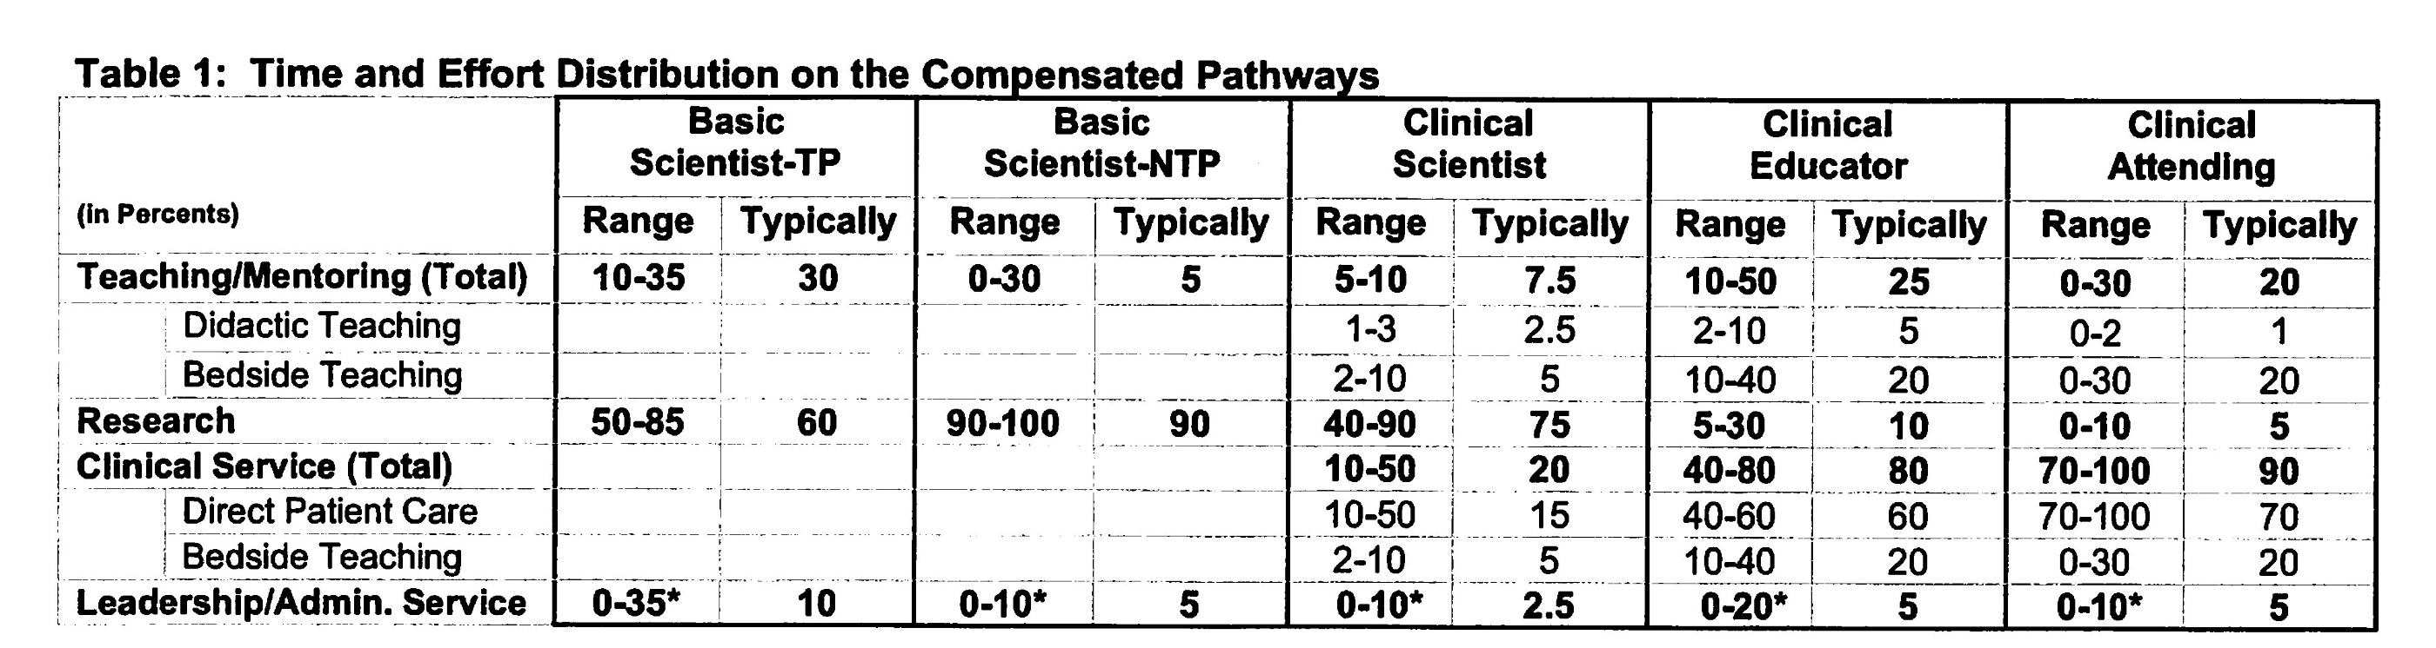

Slide 7
Typically 1 to 4 hours per week, but can range.

Slide 8

Birthday Cake

Slide 9
What kind of activities are typically expected? Assistant to Associate
Activity | Basic Scientist | Clinical Scientist | Clinical Educator | Clinical Attending
Committee participation (department, college, university) | X | X
Work in significant committees (local, regional, national) |  |  | X | X
Leadership in teaching (planning, implementing, evaluating) | X
Successful and sustained leadership of training program |  |  | X
Editorial boards (serving as a journal reviewer would count as well) | X | X | X
Study sections | X | X
Advocacy | X | X | X | X
Leadership role in section, department, hospital |  | X | X
Participation in section, department, hospital |  |  |  | X
Service professional or lay community (education, consultation) |  |  | X | X

Slide 10
Other Activities Associate to Full
Leadership in department, institution
Leadership, service or committee work for regional, national or international professional organizations
Study section chair
External advisory committee
Long-standing leadership in major courses and/or leadership ≥ college level
Sustained community service that fosters health

Slide 11
How to document
Rachel Stafford, PharmD
Examples are available at
Https://promotiontenure.uams.edu/SampleMain.aspx?cid=2
Notes:
Dr. Ward has talked about how to make sure that you are meeting the requirement and gaining the necessary experiences for promotion in this area. Let’s talk about how to document these activities so that you are able to put yourself in the best light for your reviewers so that it is very clear that you meet the criteria.

Slide 12
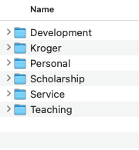
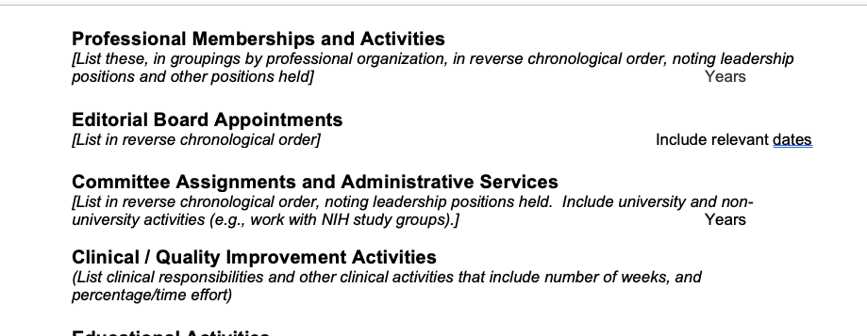
Keeping Track of Documents
Virtual or actual folders for each section of packet
Create now and update CVs quarterly
Keep annual faculty reviews to pull information from
https://www.aamc.org/professional-development/affinity-groups/gfa/faculty-vitae/preparing-your-curriculum-vitae
Notes:
One thing that was helpful to me early on was to create folders for each section of my promotion. I think the first week I started, someone was talking to me about promotion and what the guidelines were. So I started to make sure that my work was fitting inside of these boxes and these criteria. This picture here on the top right is the extent of my filing system. It has to fit in one of these folders….this is our our P&T guidelines are organized in the COP. I have a couple of extra folders outside of that for easy of access, but otherwise, it is all fitting into the buckets of scholarship, service, and teaching. Within each of these folders are folders for the criteria that fit into each of these. I have a similar filing for my email and paper documents.
The AAMC website has a template for a standardized CV that reviewers usually expect. For example, I copy and pasted the sections that would pertain to Leadership and Administrative service here. It has examples of what information should go in each section and how it should be organized, and the order of how it fits with all of the components of your CV.
Additionally, for my annual reviews in the COP, I elaborated on each section of our self-assessment and provided a great deal of detail for each section. Whenever it can time to put together my P&T packet, these self-assessment documents were critical because there where many of the details that I had already forgotten about older initiatives that I was actively engaged in in the past but not currently. I really appreciated the chace to document those each year.

Slide 13
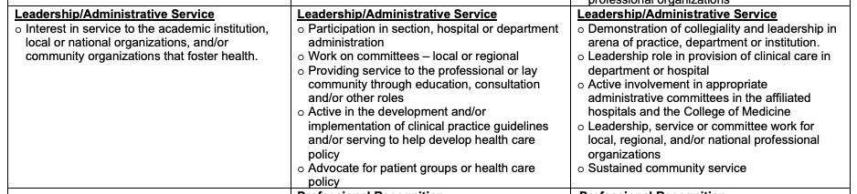
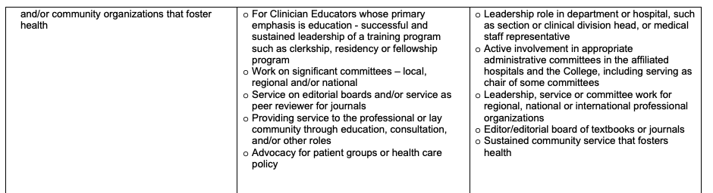
“The 3 C’s” Clear, Concise, Complete
Notes:
When you think about the information that you will put into the Leadership and Administrative Section of your packet, the first place you should look are the criteria for your particular pathway in your College’s P&T guidelines. For example, for the first table here. There are 4 bullets. It might be a good idea to copy and paste these into a document and brainstorm/jot down some ideas of how you will show that you need this criteria. For example, “Active in the development and/implementation of clinical practice guidelines and/or serving to help develop health care policy.” Likely just listing that you were on a team that did this will not be enough to clearly community your active engagement in these processes. What do you want communicate about your role?
This brainstorming can help you ensure that your final document is organize in such a way that it conveys this information. If you have trouble look at a blank page, you could also record yourself brainstorming ideas and then come back and write those ideas down. Just a little hack that I use for myself sometimes when I can’t write as fast as I can think.

Slide 14
Outline vs. Paragraphs
Notes:
These next couple of slides can give you some examples of what the structure of these can look like. Some information may be best conveyed as outlines and others may need to have a paragraph to truly convey your involvement.

Slide 15
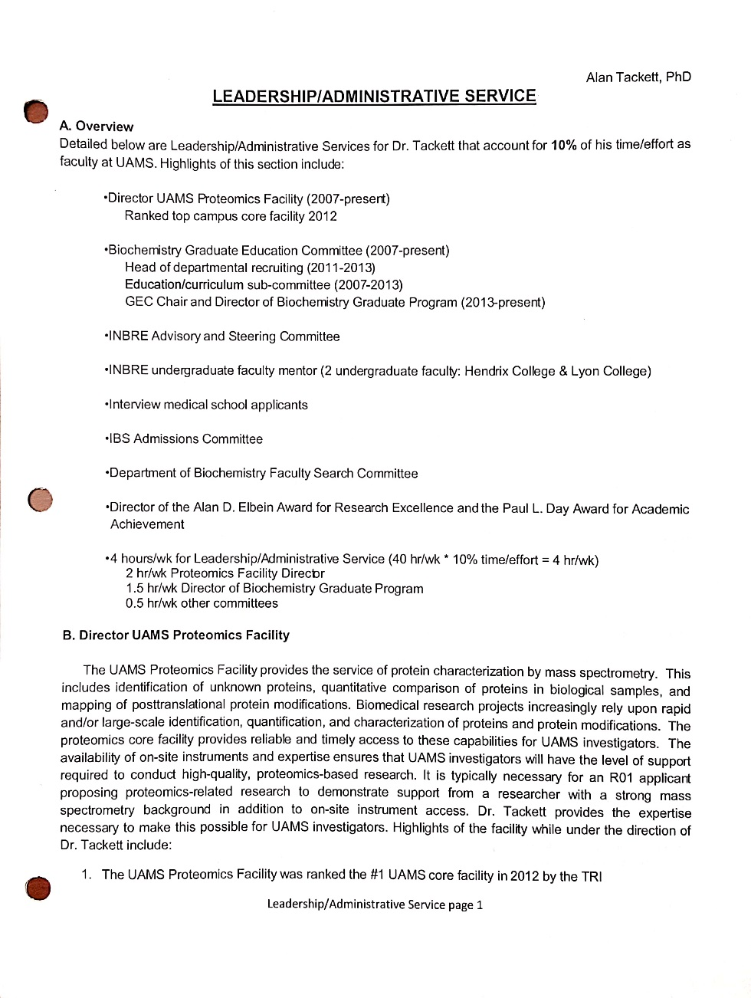
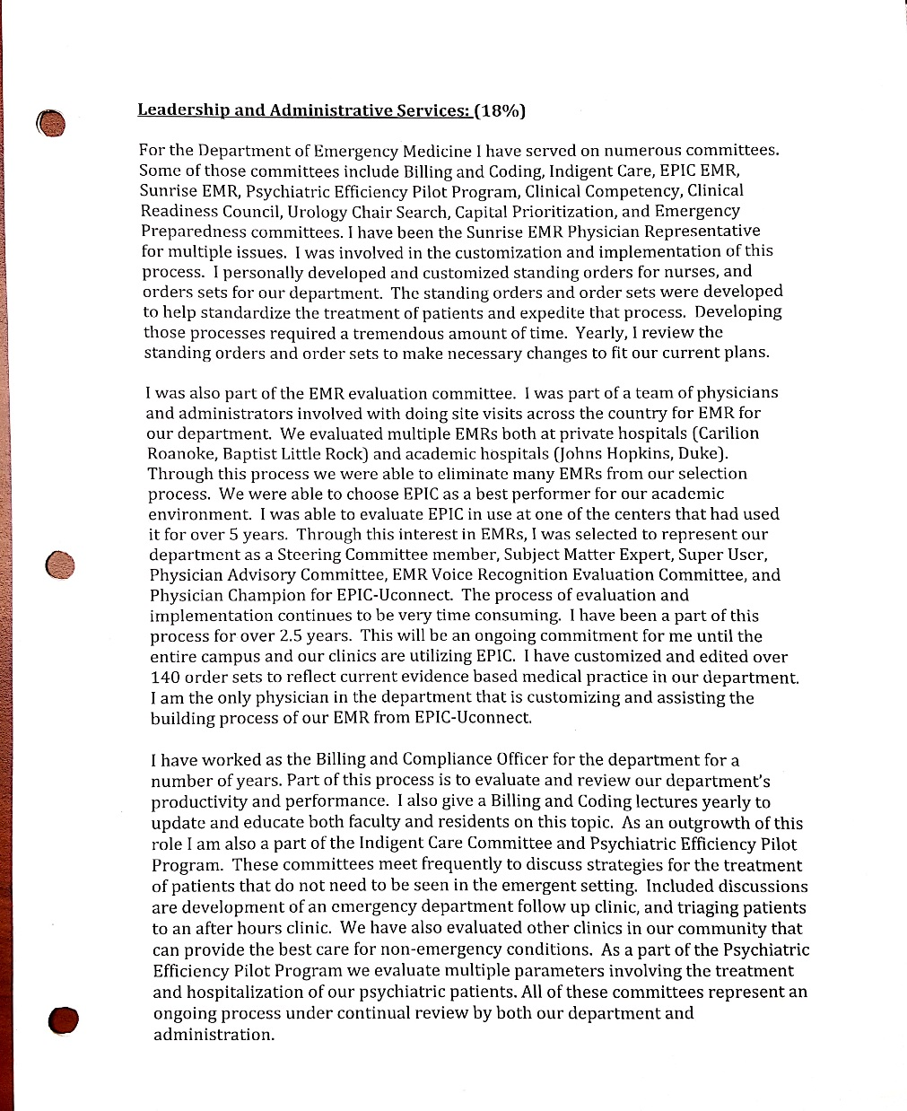
Basic Scientist
Clinical Attending
Notes:
I would encourage you that if you are going to write a long block of text that you use some subheadings to divide up the content. And I would let the criteria guide what those subheadings are. You want it to be very easy to show which piece of information you are intending to meet which criteria.

Slide 16
Completeness
Name of the activity
Nature of the activity
How you contribute to the activity
How much time you spend on the activity
Notes:
These would be some components to include to help the reviewer understand your role and level of involvement in the service.

Slide 17
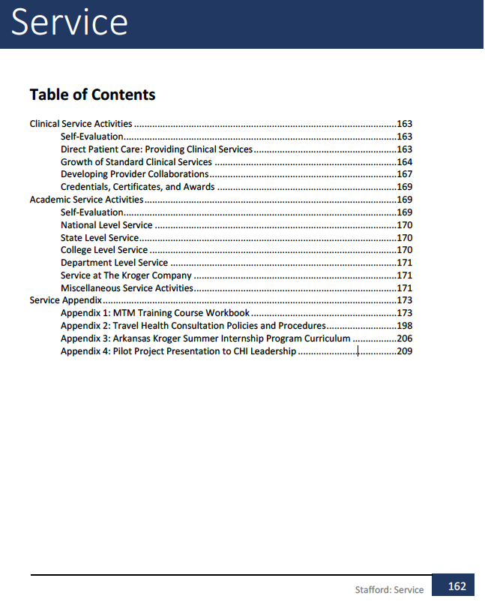
Organize your leadership/administrative/service section
National/International
Regional/State
Institutional--UAMS
College
Department/Division
Section/Unit/Team
Notes:
It is quite helpful to have a overview page and/or a table of contents are if there are many pages to the document. My packet had an overall table of contents and then each section had a more granular table of contents to give the reviewer an idea of what to expect from this section and how it relates to each other. There are some templates of how to organize the committees you are involved in. National/state/institution, etc are the common way to organize these and this is how the reviewer will expect that these are organized.

Slide 18
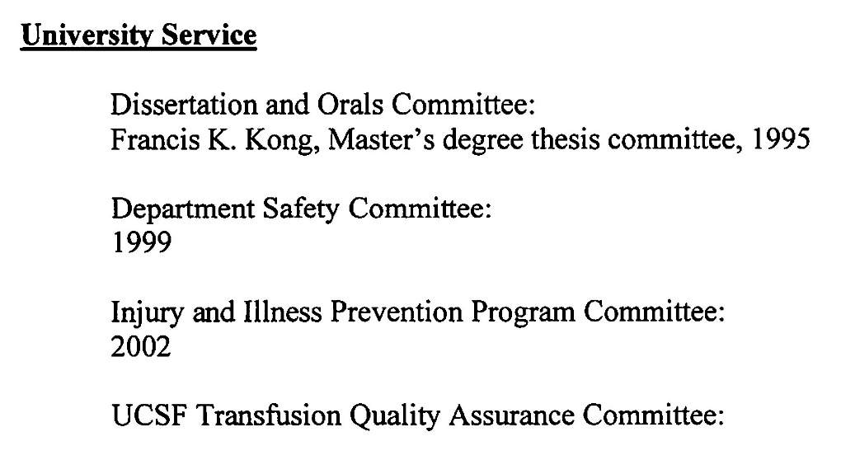
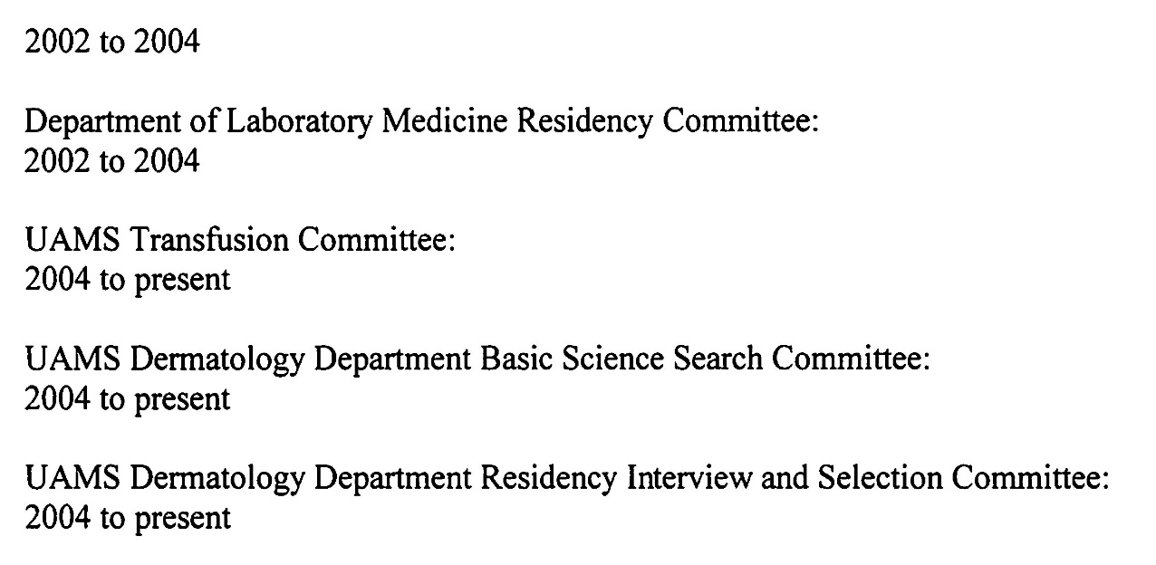
Common Mistakes Example 3: Not enough details describing committee work
Notes:
This example does not do a good job explaining what the candidates role was on the committees. It’s hard to tell what their level of contribution was or the amount of time that was spent in these committees. This can also help justify the %effort that is given and the normal ranges expected.

Slide 19
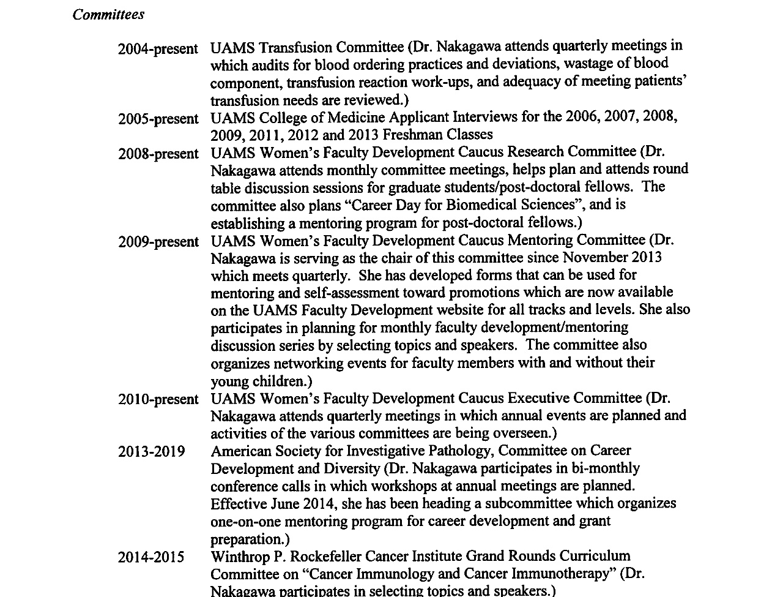
Notes:
This examples gives a much more rich detail about the level of involvement and the amount of effort into each service activity. On thing I might suggest on this one is the perhaps bold the name of the committee or some other type of formatting to make this a bit more readable and to let the formatting of the document visually help your reviewer understand how everything relates together.

Slide 20
How do I get involved in Leadership/Administrative/Service? Wendy L. Ward, PhD

Slide 21
Ask your Department Chair which committees would be appropriate to join

Slide 22
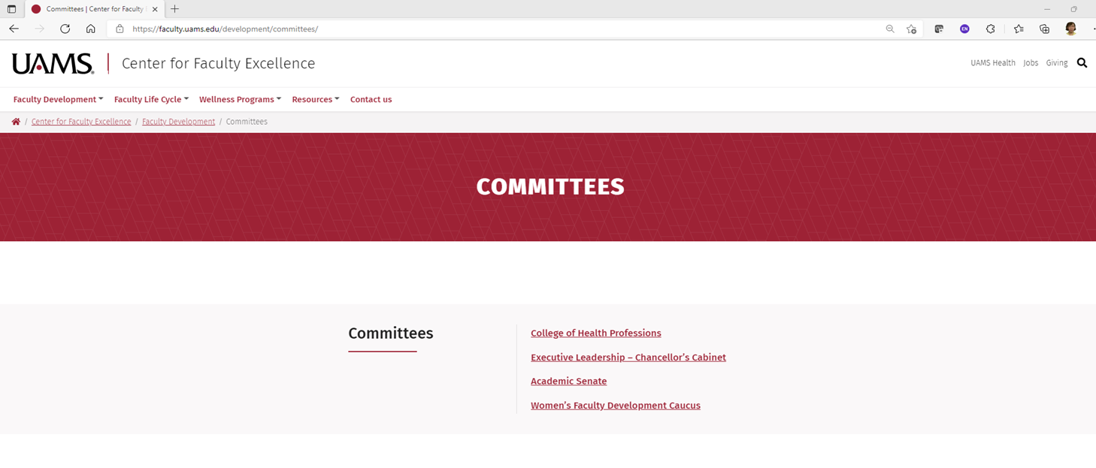
https://faculty.uams.edu/committees/

Slide 23

Notes:
Dr. Abdallah Hayar-Communications, Dr. Nukhet Aykin-Burns-Faculty Affairs, Dr. Gan?-Research Committee Contact Priya Mendiratta

Slide 24
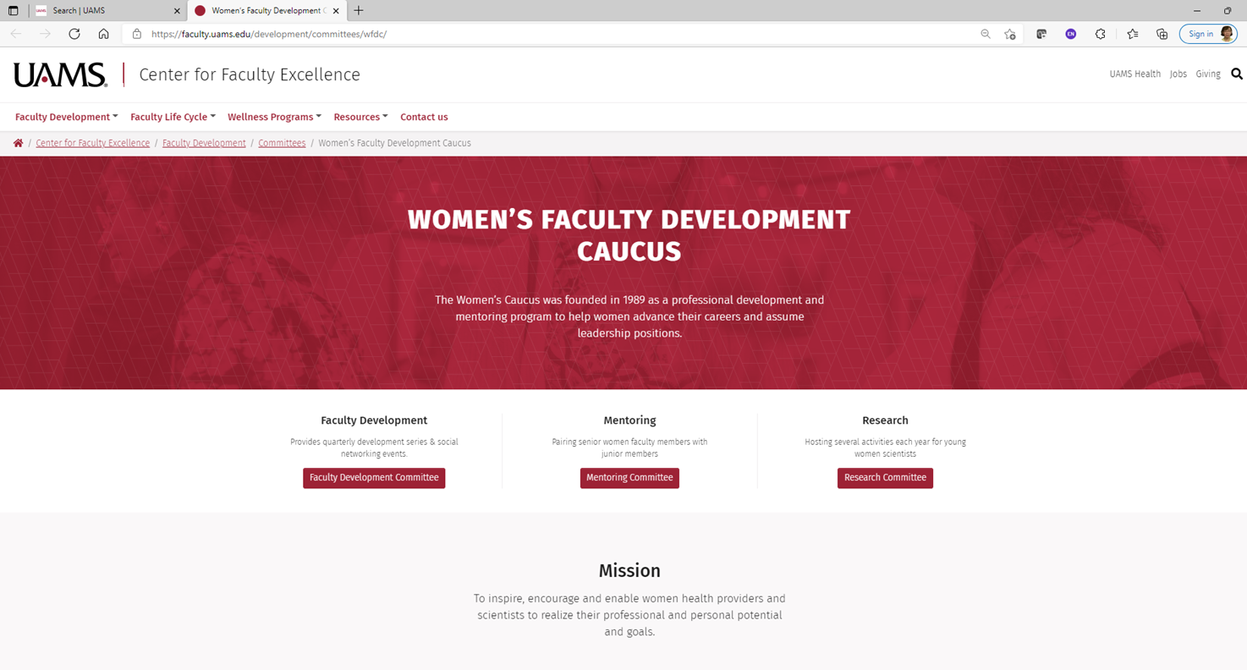

Slide 25
Check P&T guidelines for your College:
https://faculty.uams.edu/development/promotion-and-tenure/

Slide 26


