Slide 1
Documenting Your Clinical Efforts In a Way that Counts
Analiz Rodriguez MD, PhD, MBA, FAANS
Associate Professor
Vice Chair of Research
Department of Neurosurgery
Winthrop P. Rockefeller Cancer Institute
UAMS
Nirvana A. Manning MD, FACOG
Professor
Chair, Department of Obstetrics and Gynecology
Service Line Director of Women’s and Infants Service Line
UAMS

Slide 2


Slide 3
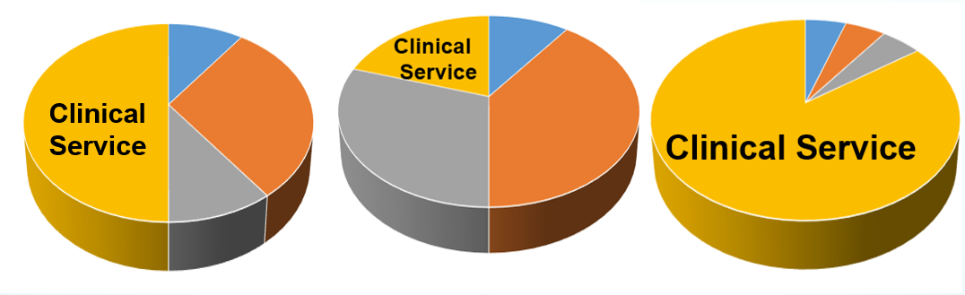
What is Your Distinct “Niche” Area in Clinical Service?

Slide 4
Clinical Service Pillars Capturing evidence of dissemination activities
Inpatient
Outpatient
Consult service
Service to the Community
Professional Development
Patient Education

Slide 5
Clinical Activities Portfolio
Service Excellence
Uniqueness of clinical practice
Volume of patients/ RVUs
Clinical leadership: UAMS, regional, national
Community outreach activities

Slide 6

Service Excellence

Slide 7
Narrative Statement of Clinical Service
1-3 page(s) first-person statement about your clinical service in the context of your clinical focus and expertise
Describe your clinical activities and responsibilities in detail
Written so that reviewers outside your discipline can understand your work (avoid jargon!)
“A really smart person in a completely different field can understand”
To get a “picture” of who you are (don’t assume they know you are a internist or a surgeon!)

Slide 8
Example of Clinical Service
“As part of clinical service, I participated in a performance improvement project: Quality Oncology Practice Initiative (QOPI). I also coordinated and supervised a quality improvement project entitled “Distress Management in Cancer Patients” and participated in obtaining a Certificate of QOPI.
I rounded in inpatient service 12 to 14 weeks per year, from Monday through Friday. The number of inpatient daily census averaged around 25 complex patients at any given time.
At the same time, I start building my outpatient clinic in gastrointestinal, thoracic, and genitourinary cancers that staff 5 half-days each week. Subsequently, as outpatient activity increased, I was able to balance and adjust inpatient rounding. Now, my outpatient workload consists of approximately 12 to 18 patients per half-day clinic. In addition, I provide consultations on inpatient service, averaging 5 to 10 consults per week.
From July 2014 through April 2017 I saw over XXX new patients and conducted XXX follow up patient visits with a total of XXX outpatient visits.
The care of oncology patients requires evidence-based and multidisciplinary coordination of care. Hence, the need for a detailed approach to understanding the complexity of each patient’s problems that require coordination of a multi-subspecialist team.”

Slide 9
Example of Clinical Service
1. “Attend consultation service (19-26 weeks on-call per year).
There has been a dramatic increase in the number of genetics consults since my arrival.
2. General Genetics clinics (3 per week).
I have dramatically altered the scheme by which I see patients in general genetics, which resulted in a 152% increase in clinical volume in one year.
3. Attending geneticist, Cleft, and Craniofacial Clinics (weekly).
This is one of the biggest cleft clinics in the State/US, and we have established genetics as a vital part of the effort.
4. Marfan syndrome clinic (2 days per month)
This clinic has grown in 3 years from 2 patients per month to 20+ patients per month
5. Genetics of hearing loss.
While not a separate discrete clinic, I have developed a clinical program for the genetic evaluation and testing for hearing impaired children and adults. Not only has this expanded and enhanced the clinical care for these patients, it has produced substantial research and educational opportunities as well.
6. Supervision of genetic counselors (several per month)”

Slide 10
Optimal Patient Care
Results of quality or utilization reviews
Practice audits
Health outcome studies that directly measure your performance in providing personal care to patients
Attach supplemental information

Slide 11

Uniqueness of Your Clinical Expertize

Slide 12
Unique Skills
Fellowship or other subspecialty training not otherwise widely available?
Is there a specific technique or service only you provide?
A specific patient population that you serve (language, etc)?
Clinical case volume which contributes to residency minimum required numbers?
New program you initiated

Slide 13
Scope of Clinical Activities
Sites of practice
Length of service
Numbers of patients or procedures and responsibilities
Describe your mastery of specific clinical techniques
Document the number and type of clinical referrals to your specific practice from outside UAMS
Clinical presentations
Podcast, SIMS

Slide 14
Clinical Time Allocation
Details on quantity and complexity of cases (productivity)
Documentation of clinical activities from departmental, hospital or clinical records
Check with your division chief or clinical division manager for documentation
Reports related to patient outcome, quality, and safety (personal data from practice plan, hospital, or national data)

Slide 15

Volume of Patients/ High RVUs

Slide 16
Clinical Time Allocation - Quantity
Reports related to the assessment of clinical productivity (RVUs, inpatient, outpatient, consults, OR)
Present in a Table/Graph format
Clinical RVUs
Number of months on inpatient service
Number of consults per month/per year
Number of clinics outpatient

Slide 17
Clinical Service
Be sure your % of clinical effort correlates to UAMS target in your P&T packet (Look over guidelines!)
If your department uses another national standard for comparison of workload expectations, substitute that standard for the UAMS target and briefly describe the basis for its assessment.
Documentation may be obtained from the Department Administrator
Metrics/Benchmarks may also be available through Cancer Institute

Slide 18
Clinical Time Allocation - Quantity
If your clinical FTE assignment includes leadership or administrative components that will not result in billable RVUs, adjust your actual clinical FTE to an “effective clinical FTE” and provide an explanation in a footnote.
E.g. if you have 75% clinical assignment which includes 25% assignment to provide administrative oversight of an ICU beyond the time of providing clinical care, base your RVU targets on a 50% clinical FTE and place an “*” for each year with a clinical FTE that differs
Correlate with Teaching and Education
If your schedule reflects a lot of time for research/administrative duties, then production in those categories should correlate.

Slide 19
Clinical Time Allocation - Quantity
Illustrate RVU production
Should correlate with % clinical allocation
If any deviances, may help to explain why (maternity leave, etc)

Slide 20
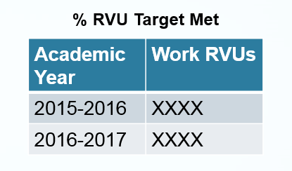
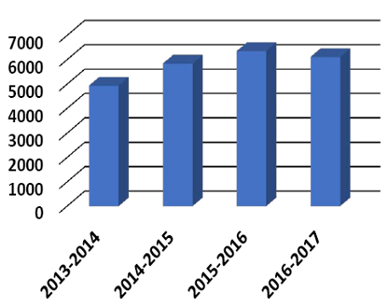
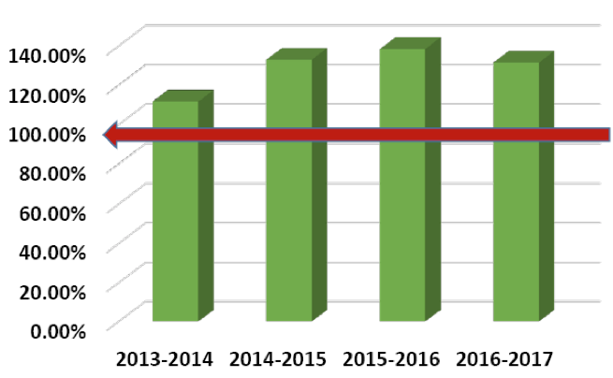
Work RVUs

Slide 21
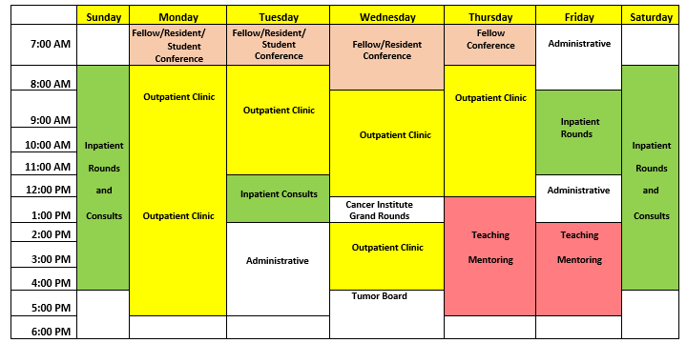
Weekly Schedule You may include a sample of a weekly calendar that depicts the range of your clinical duties

Slide 22

Clinical Leadership

Slide 23
Clinical Service Portfolio
Development of a special program that attracts referrals and enhances the reputation of UAMS, based on clinical best practice methods
Examples:
creation of a new patient service
novel diagnostic or therapeutic practice
development of innovative techniques or improvements in clinical practice
development of mechanism to improve the efficiency of health services
improvement of a training program within the clinical unit
playing a key role in the development of clinical practice guidelines
development of written, video, audio or computer‐based teaching materials related to clinical care
involvement in administrative activities that support and enhance University based patient care
director of clinical program

Slide 24
Clinical Service in Leadership
Trials participation and patient recruitment (cooperative trials, tissue bank)
Contributions toward institutional accreditations (NAPBC)
Committees with clinical service initiatives- start early and list all- (Quality improvement)

Slide 25
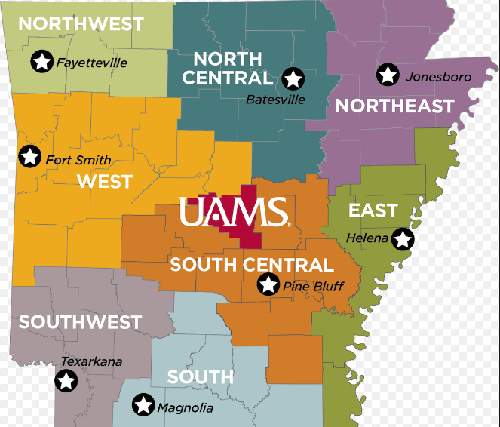

Clinical expertize at UAMS, regional,
and national levels

Slide 26
Committees
Appeals Board
Continuing Medical Education
Council of Department Chairs
Curriculum Committee
Dean’s Executive Committee
Dean’s Lectureships and Alumni Awards Committee
Dean’s Senior Advisory Council and ILLUMINE
Educational Faculty Awards Committee
Graduate Medical Education
MD/PhD Advisory Committee
Medical Student Admissions Committee
Medical Student Promotions Committee
QUEST
Research Council
Residency Position Allocation Committee
Scholarship Committee
Special Test Taking Accommodations
Student Discrimination Grievance

Slide 27

Community Outreach Activities

Slide 28
Community Outreach Activities
Patient-centered community engagement/education
Invitations from public and lay groups, including news media
Speaking in the community about awareness
Speaker for Support groups
Preventive health screening

Slide 29
Clinical Service Pillars
Inpatient
Outpatient
Consult service
Service to the Community
Professional Development
Patient Education

Slide 30
Professional Development
Indicate efforts regarding ongoing self‐evaluation and upgrading clinical skills
Additional skills certifications (US, oncoplastics, ATLS, etc)
Career development opportunities and seminars on campus
Board certification
Maintenance of certification
CME courses
Describe any implemented changes in practice that resulted from self-evaluation
Professional conferences
MASTER class
Good Clinical Practice Basic Course
Quality Improvement Projects

Slide 31
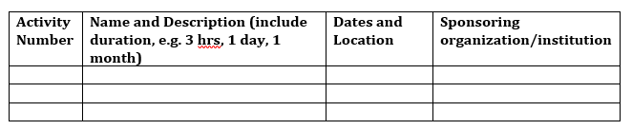
Professional Development

Slide 32


Who are the Judges of Your Quality of Patient Care?

Slide 33
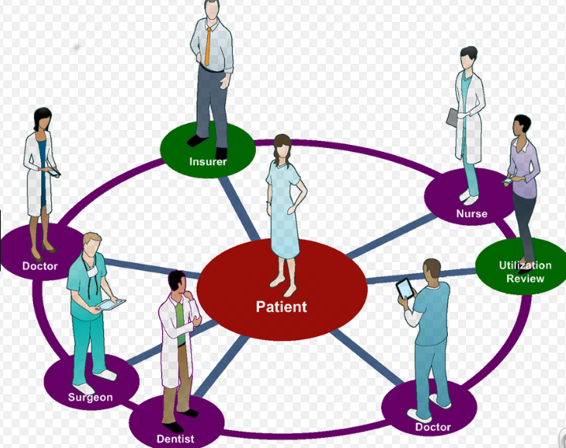
Who are the Judges of Your Quality of Patient Care?
Patients and families
‘Star’ rating patient satisfaction
Can include specific comments from surveys
Consider including letters/emails from patient/family
Acknowledgement by patients of new protocols or handouts
Patient testimonials, donations in honor of the clinician by a grateful patient
Community recognitions or awards
Do not include any patient identifiers or protected health information

Slide 34

Patient Satisfaction Survey NRC Health’s Star Rating 4.9 out of 5
“91 Ratings”
“67 Comments”
“Dr. “_” is an excellent physician, professional, competent and caring.”
Indicate if unsolicited by creating a heading “Unsolicited” for any included direct comments

Slide 35
Who are the Judges of Your Quality of Patient Care?
Physicians Colleagues in the same area of expertise
- Honors or recognition from colleagues (for example, “clinical excellence” awards)
- Election to medical staff or professional society leadership positions. Speaker evaluation
- Asked to speak as an expert in regional conference
Chairpersons
Referring Physicians - Regional reputation, referral patterns
Service Line Director
Students, residents, fellows - Summarize evaluations, letters
Nurses, practice managers

Slide 36

Letters of Recommendation
1. External Required LOR
2. Letter from the Department Chair
3. Supplemental letters of the clinical performance
Letters from peers, colleagues, consultants and referring physicians commenting on patient care ability and effectiveness inside or outside the institution
Example: Statements from colleagues who have observed you at a clinical site or who have referred patients to you.
Statements from clinical service line directors, nursing director, or others that define clearly your role in clinical enterprise.
Highlights how your performance compares with other practitioners (inside or outside the institution)
Letters from clinical leadership attesting to clinical excellence (if important to the candidate’s narrative or if portfolio does not have other metrics readily available)

Slide 37


Common Problems
Clinical service activities are based on only one observation
Inadequate documentation or no summary table provided of clinical service evaluations completed by students/residents/fellows
Inadequate documentation of patient care activities
Inadequate documentation % of clinical effort
Too much “fluff” (1000 pages portfolio)

Slide 38
Suggestions
Phone a friend
Look at sample packets or ask a colleague in a similar field who has gone through the process and knows what your practice is like
Organize
P&T folder in email vs specific subfolders already organized into categories
Use their language
Specifically state “this not only demonstrates excellence in clinical service but also leadership/scholarly work/commitment to education…”

Slide 39

What Can You Do Now?
“Be a pack rat”
Track your self‐evaluations
Create folders (electronic, email, file folders)
Keep detailed records, weekly update your P&T folders
Clarify your time and effort allocation
Update CV every 1-3 months
Check with your department to ensure that you meet your department’s internal deadlines!
Notes:
Recordkeeping Practices
Mentoring Committee

Slide 40


